Slide 1
Introduction to Computers Lecture 1
By Zarmina jahangir
Department of Computing
Riphah SCHool of Computing and INNOVATION

Slide 2
Outline
Course Objectives
Computers
Hardware
Types of Computers
Application of Computer
Software
Programming Languages
Internet
Networking
Computer privacy

Slide 3
Course Objectives
Discuss Fundamental Concepts of Computers
Learn how Computers works
How computers are Used as Practical Tools for Solving Personal Business, and Academic Problems
Learn Basic Computer Skills
Enabling students to work with various office software's
Learn Basics of how to do programming

Slide 4
Computer Application
What are some examples of computer applications in society?
Education
Finance
Government
Health
Care
Science
Publishing
Manufacturing
Travel

Slide 5
Impacts of Computers
Shift from print to digital media
Online access and file transfer possible
Networking and sharing of information resources possible

Slide 6
What are computers
A computer is an electronic machine that has the capability of performing computation and processing on the supplied data. It can also store data as well as generated results
A computer is a machine that, under a program’s direction and control, performs four basic operations:
Input
Processing
Output
Storage

Slide 7
What is a program
A program is a list of instructions that tells the computer how to perform these four operations in order to accomplish a task.

Slide 8
Information life cycle
Input
The computer accepts the data that has been represented in a way the computer can use
“The term data refers to unorganized raw material”
Processing:
The computer performs arithmetic or logical operations on the represented data
Storage:
The computer saves the result so that they can be used again
Output:
The computer can show the result of processing in a way people can understand
“The processed data becomes information”.

Slide 9
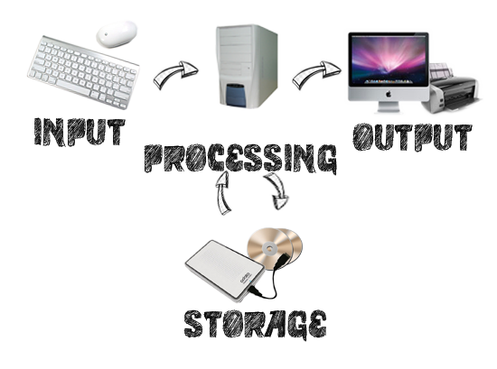
Information life cycle

Slide 10
Computer Systems
A computer system is a collection of related components that have all been designed to work together smoothly. It includes:
Hardware : physical components of computer, including the computer itself and matched peripherals
Software : Programs that run on computer

Slide 11
Hardware
Physical components of computer

Slide 12
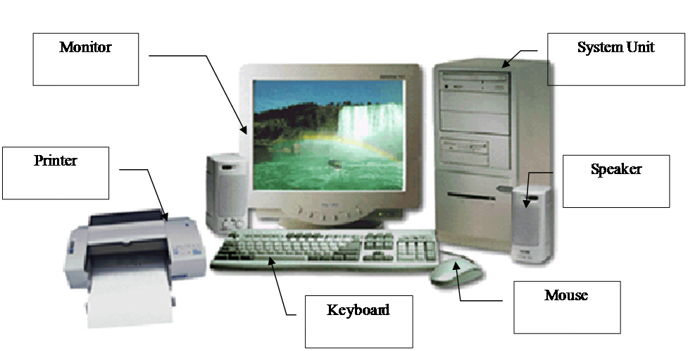
Computer Basic Components

Slide 13
Input Devices
Input devices enable user to get data into the computer for processing.
Input devices also used to give a command.
Keyboard
Input type : character, numeric, alphanumeric and special functions
Mouse
Input type : pointing, cursor movement, special functions
Microphone
Input type : voice, spoken commands

Slide 14
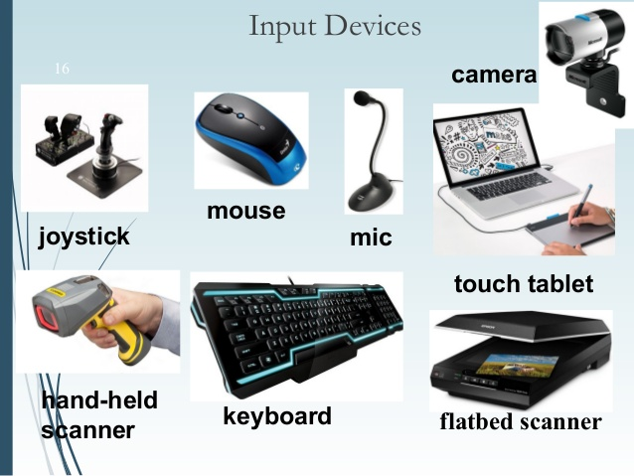
Input Devices

Slide 15
Output Devices
Output devices shows the result of processing operations.
Monitor
Output type : CRT, LCD or LED display
Speakers
Output type : Sounds, Speech
Printers
Output type (on Paper) : Inkjet, laser

Slide 16
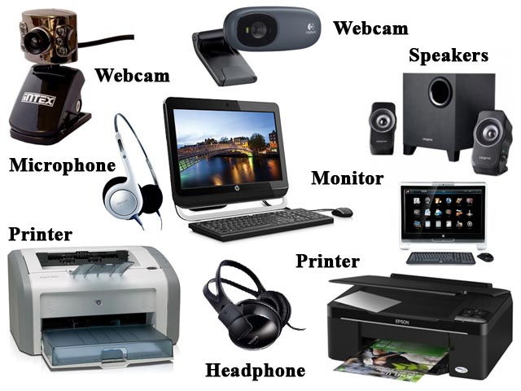
Output Devices

Slide 17
Input Output Devices
Some devices are input and output
Touch screens

Slide 18
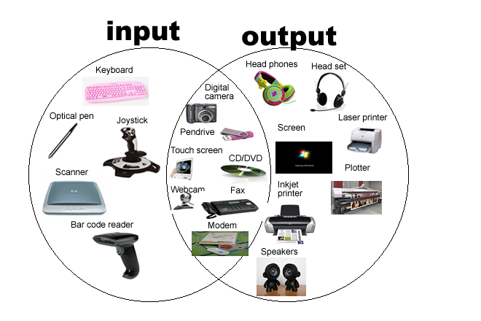

Slide 19
Processing Device
Processing device is called “Central Processing Unit (CPU)” located in a case called System Unit
Now a days, computers has mini CPU called micro-processor or processor consist of an electronic chip
System unit contains additional components along with central processing unit :
Motherboard
Memory
Buses
Expansion slots

Slide 20
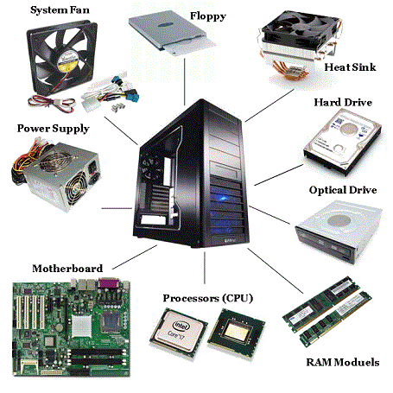

Slide 21
Processing Devices
What are Control Unit and ALU?
The arithmetic/logic unit (ALU) contains the electronic circuitry that executes all arithmetic and logical operations.
The control unit (CU) of the CPU contains circuitry that uses electrical signals to direct the entire computer system to carry out, or execute, stored program instructions

Slide 22
Memory Devices
Stores data or programs
Random Access Memory (RAM)
Volatile Memory
Stores current data and programs
More RAM results in a faster system
Read Only Memory (ROM)
Permanent storage of programs
Holds the computer boot directions
Cache?
Virtual Memory?

Slide 23
Storage devices hold data permanently, all of programs and data that computer system uses.
Magnetic Storage
Magnetic disk or magnetic tapes
Stores data encoded magnetically
Optical Storage
CDs, DVDs
Stores data in form of microscopic pits that are etched into the surface of a disc
Uses a laser to access data

Slide 24
Storage media vs. Storage Devices
Storage media
Physical material on which data, instructions, and information are stored
Storage device
Records and retrieves items to and from storage media

Slide 25
Communication Devices
Communication devices are used to move data between computers
Communication devices enable computers to connect to computer networks
“Modem
NIC (Network Interface Card) or network connector
Wifi Cards
Notes:
A Computer network connect two or more computers by means of a connection on some medium”

Slide 26
Computer Bus
Bus is use for computer components internal communication

Slide 27
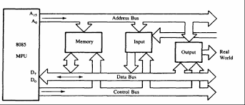
Bus Structure

Slide 28
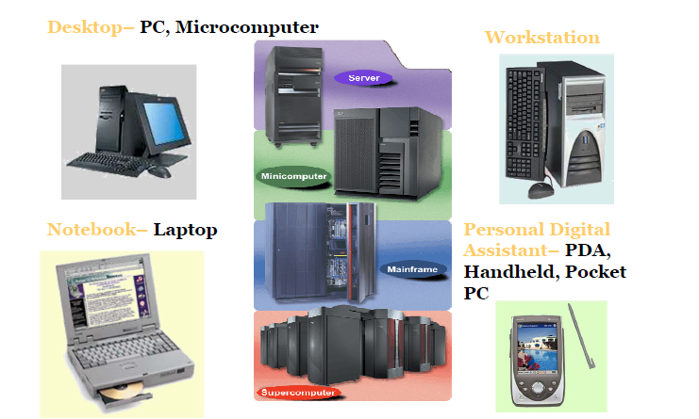
Types of Computers

Slide 29
Computer Software
Software consists of the programs that give the computer’s hardware its step-by-step instructions.
Software is created by programmers using a programming language.
Programs contain units called files.
Transferring a program into the computer’s memory is called loading.
Once loaded into memory the program’s instructions are carried out or executed.

Slide 30
Types of Software
System software
“All programs that help the computer function properly”.
Windows
Application software
“All the programs you use to perform a task such as writing a letter or browsing the World Wide Web”.
MS office

Slide 31
System Software
Most important software
Operating system
Provides support for running application software
Coordinates the various functions of the computer’s hardware
System utilities
Are programs for optimizing computer performance.
Example
Operating system
Windows XP
Network Operating System
Windows Server 2003
Utility
Symantec AntiVirus

Slide 32
Operating systems
Command-line interface
Users type instructions at the keyboard, one line at a time
Examples: MS-DOS, DOS, UNIX
Graphical user interface (GUI)
Users choose items from menus by using a pointing device to click on icons which represent resources and commands
Examples: Windows, Mac OS

Slide 33
Application Software
Application software includes all programs that enable us to use the computer in a useful way.
Accomplishes a specific task.
Most common type of software
MS Word
MS PowerPoint
Paint
Covers most common uses of computers.

Slide 34
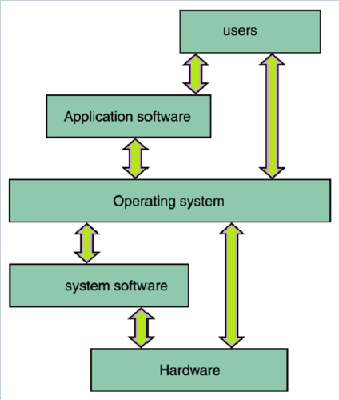
How computer works

Slide 35
Assignment#1
Write down about History and generations of computers
What is cache memory and virtual memory. Write a brief note about these two types of memories.
Submission deadline: ?
Note: Type your Assignment on computer and submit it in the proper format in hard form

